Slide 1
Application
Development
Yatusan Selvaranjan iAMDT 1620

Slide 2
Framework solution you would propose
to develop “ToDoNotes”
The framework I would prefer here is HYBRID.
Fast to develop
Lower Requirements
One code base for multiple platforms
Cheaper prices
Faster speed to market

Slide 3
Comparison of the Frameworks
Hybrid app –
Pros – Fast to build, Easier to change and update, Cheaper to build
Cons - require a constant internet connection to deliver the full range of features to the users,
Poor user experience, Limited capabilities.
Native app –
Pros – Native Apps Offer Speed, Native Apps Provide a Recognizable Look and Feel, Native Apps
Work Offline
Cons – Subject to slow app store reviews, Expensive Development, No Flexibility
Progressive Web app –
Pros – Offline connectivity, Secure, Platform consistency
Cons – Limited Browser Support, No Download Store Presence, don’t have as much access to your operating
system

Slide 4
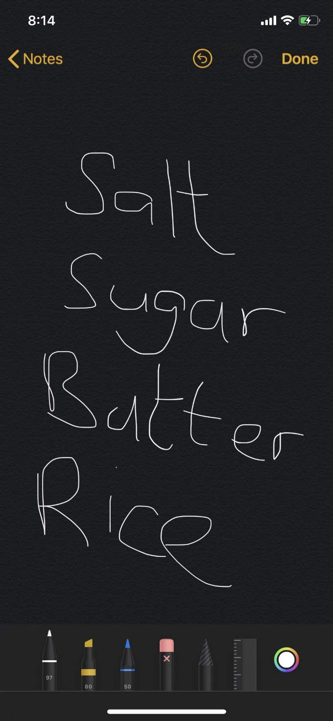
Value-added feature for ‘ToDoNotes’
In the ToDoNotes application I would like to incorporate
doodle feature within the Application.
Using this feature the user can draw or hand-write the list
of items that he/she has to list down
Something like this

Slide 5
Considerations done when deciding a mobile
application framework?
Time of delivery (Release of application to the users hands)
Cost / Expenses
Flexibility
Security
Performance
Compatibility
Integration

Slide 6

My favourite application & why?
My favorite application is Maps.me, because that provides offline maps using OpenStreetMap data.
You can view live speed of yourself in a glance which is within the app. It exact as on Google maps,
Even more features than that.
Currently I’m using iPhone, in that it works seamlessly
Available for both iOS & Android.

